Slide 1

BBA 3rd SEM Session(2023-24) Business Suite
Submitted to:
Pankaj Tiwari
Submitted By:
Shankh Bansal
(AU22C1013)

Slide 2

What is business profile
A business profile on Facebook, also known as a Facebook Business Page, is a dedicated online presence created by businesses, organizations, or public figures to interact with their audience on the Facebook platform. It is distinct from personal profiles and is designed for commercial or promotional purposes.

Slide 3
Characteristics of a Facebook Business Profile:
Branding
Information
Content sharing
Insight
Review & Rating
Advertisement
Call to action button

Slide 4
Advantages of a Creative Business Profile on Facebook:
Enhance Brand loyalty
Engagement boost
Professionalism
Differentiation
Story telling

Slide 5

Importance of a Creative Business Profile on Facebook:
Engagement and Conversions
Brand consistency
Reflecting innovation
Competitive edge
First Impressions

Slide 6
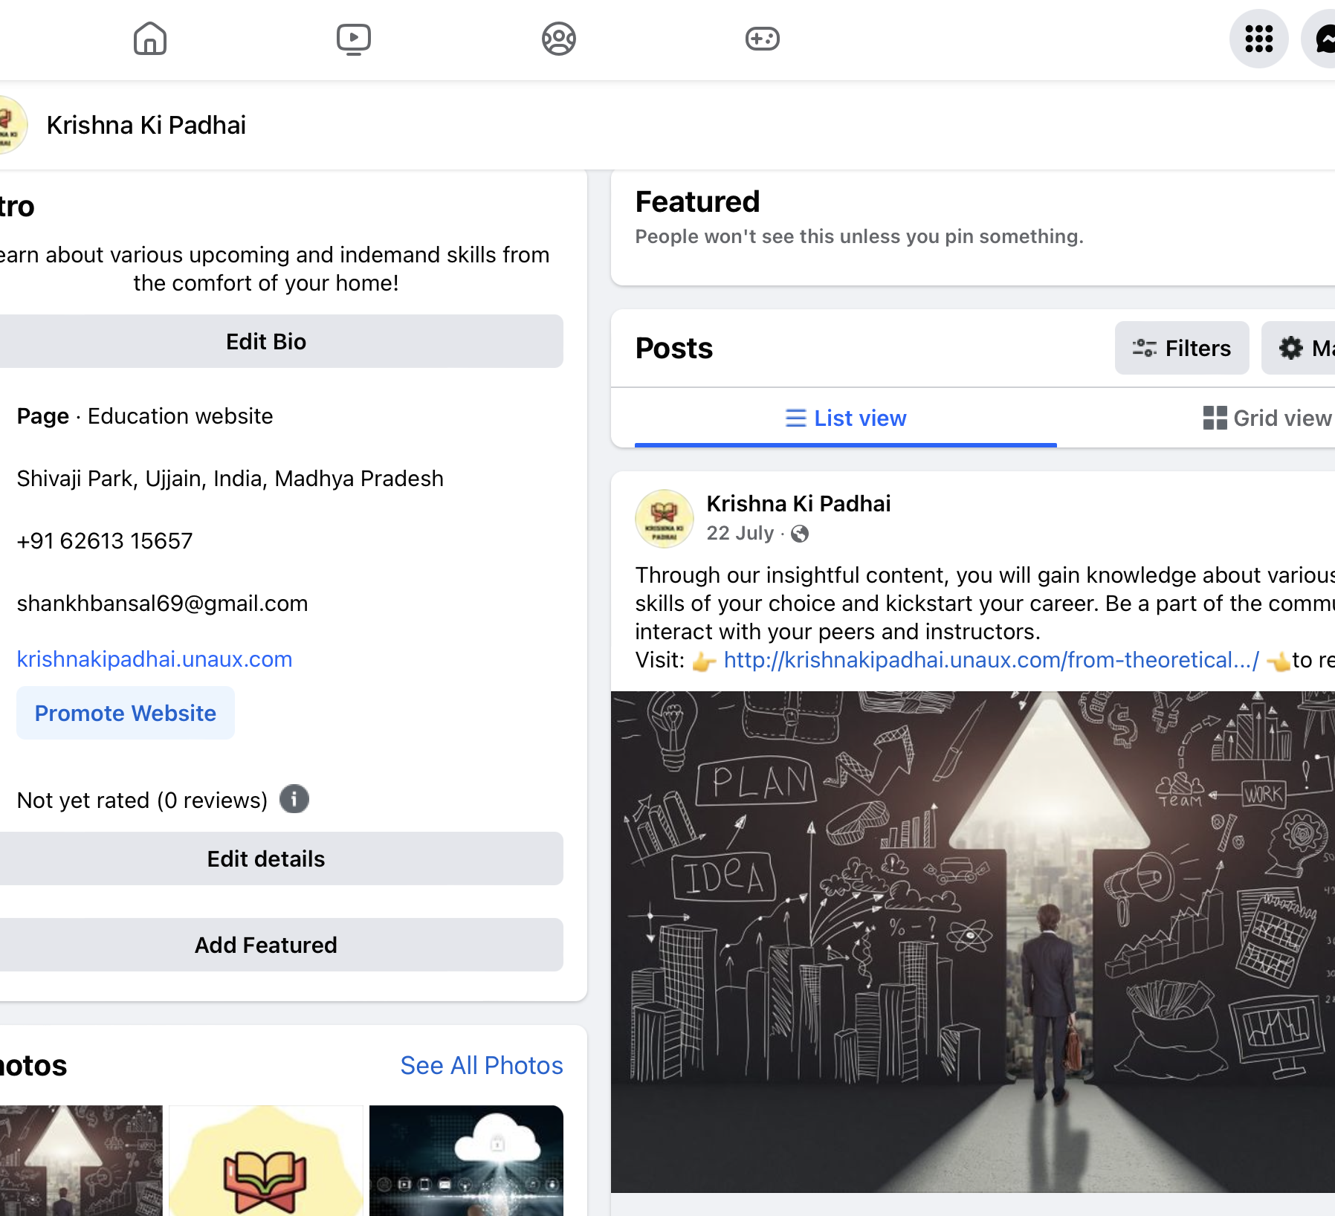
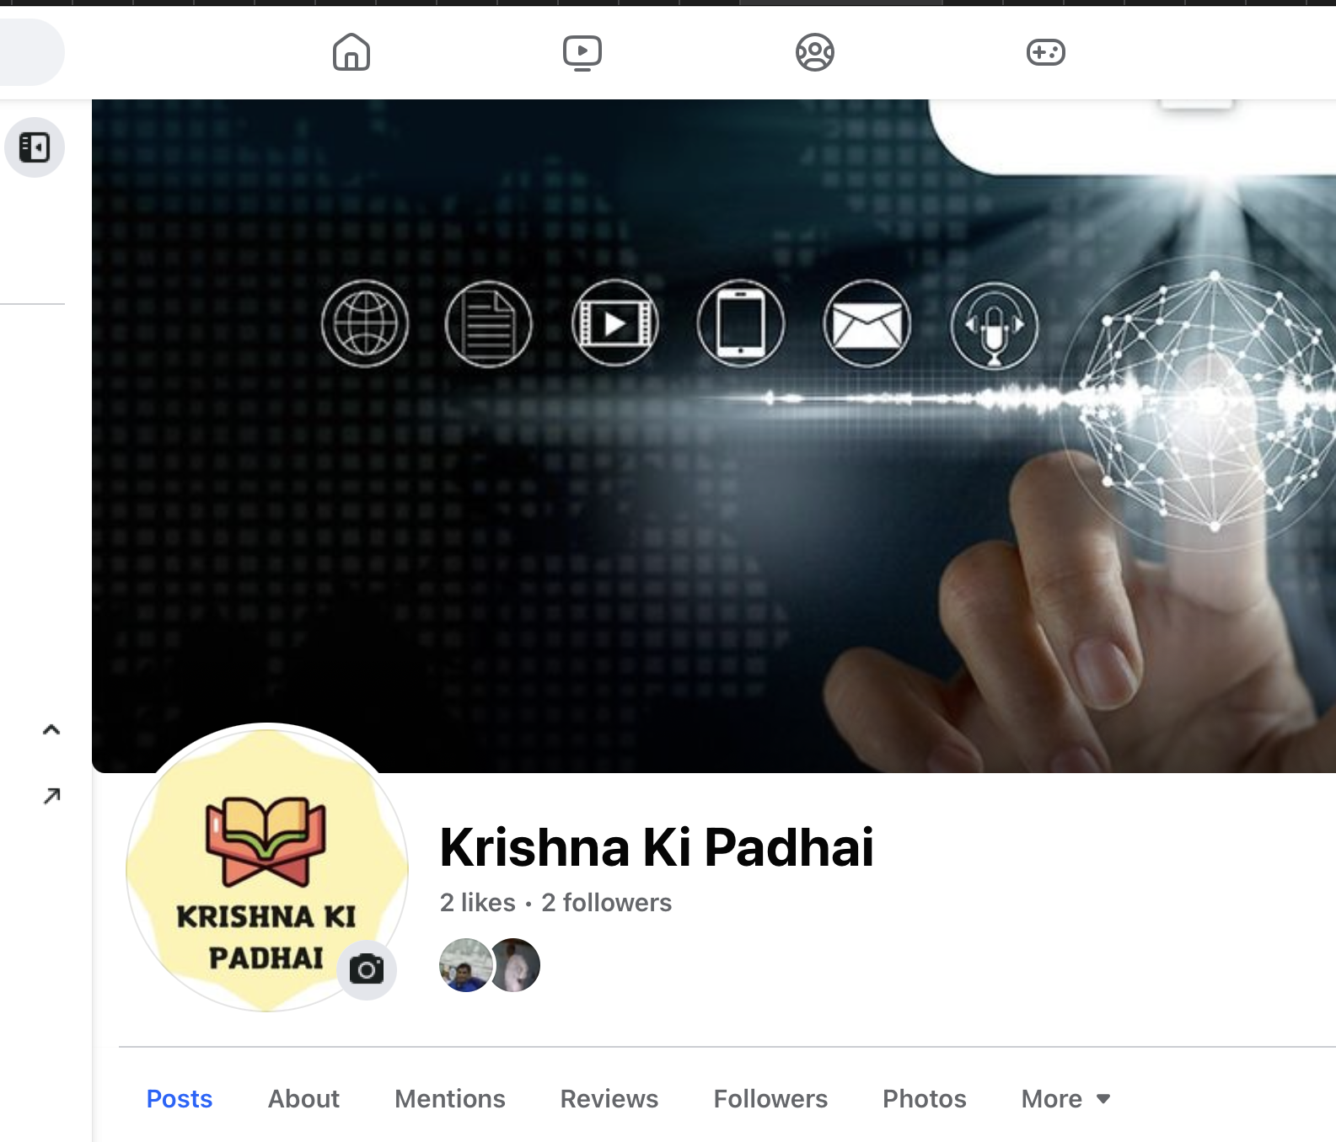
Glimpse

Slide 7

Summary
A creative business profile on Facebook not only provides numerous advantages but is also essential for establishing a strong online presence and effectively engaging with your target audience.

